Slide 1

Oriental Institute of Science and Technology, Bhopal
Department of Electronics and Communication
Engineering
MINOR PROJECT
Project Name : Automatic Ventilators using Arduino with Blood Oxygen Sensing For Covid Pandemic And More
Guide name: Prof. Hasnine Mirza Sir
Headed By Our HOD:
Dr. Manish Sawale Sir
S.No. | Name | Enrollment
1. | AYUSHI DASGUPTA | 0105EC181039
2. | ANIMESH KUMAR | 0105EC181020
3. | AYUSH SAHU | 0105EC181036

Slide 2
ACKNOWLEDGEMENT
"It wasn’t possible to prepare a project report without the assistance & Encouragement of other people. This one is certainly no exception" We would like to extend my sincere & heartfelt obligation towards all the personages who have helped me in this endeavor .
We are ineffably indebted to Prof.Hasnine Mirza Sir and also our Head Of Director “Dr. Manish Sawale Sir “ for conscientious guidance and Encouragement to accomplish this project. I extend my gratitude to ORIENTAL INSTITUTE OF SCIENCE AND TECHNOLOGY for giving me this opportunity. We also acknowledge with a deep sense of reverence, my gratitude towards my Parents and member family, who has always supported me morally as well economically.

Slide 3
INTRODUCTION
“Amid the global crisis caused by the corona virus pandemic, hospitals and healthcare facilities are reporting shortages of vital equipment. As makers it's our responsibility to combat the shortage by constructing makeshift-open-source substitute devices. Our country might be in a lock down but our ingenuity isn't ! One important device for which demand has ramped up is ventilators for patients who need assistance with their breathing due to the respiratory effects of COVID-19. “
Human lungs use the reverse pressure generated by contraction motion of the diaphragm to suck in air for breathing. A contradictory motion is used by a ventilator to inflate the lungs by pumping type motion.
A ventilator mechanism must be able to deliver in the range of 10 – 30 breaths per minute, with the ability to adjust rising increments in sets of 2. Along with this the ventilator must have the ability to adjust the air volume pushed into lungs in each breath. The last but now the least is the setting to adjust the time duration for inhalation to exhalation ratio.
Apart from this the ventilator must be able to monitor the patients blood oxygen level and exhaled lung pressure to avoid over/under air pressure simultaneously. The ventilator we here design and develop using Arduino encompasses all these requirements to develop a reliable yet affordable DIY ventilator to help in times of pandemic.
We here use a silicon ventilator bag coupled driven by DC motors with 2 side push mechanism to push the ventilator bag. We use toggle switch for switching and a variable pot to adjust the breath length and the BPM value for the patient

Slide 4
Software and Hardware requirements
HARDWARE Requirement
S. No. | Component Name | Quantity/version
1 | Arduino Uno | 1
2 | Blood Oxygen Sensor | 1
3 | Pressure Sensor | 1
4 | Servo Motor | 1
5 | Breather Mask | 1
6 | Valves & Joints
7 | Air Breather Bag | 1
8 | Push Rods | 1
9 | Connector Rods | 1
10 | Gear Mechanism | 1
SOFTWARE USED
 | 1.ARDUINO IDE 2.SPICE SIMULATOR

Slide 5
HARDWARE Requirement
S. No. | Component Name | Quantity/version
1 | Buzzer | 2
 | Timer | 2
3 | LCD Display IC | 1
4 | Gear Mechanism
5 | PCB & Breadboard | 1
6 | Cables | 1
7 | IC & IC sockets
8 | Push Button | 4-8
9 | Transformer/Adapter | 1
10 | LED,Diode,capacitor,
11 | Plastic Module and ETC

Slide 6
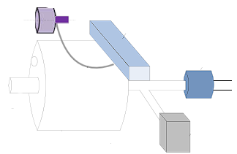
Methodology
An IoT based motor drive of clockwise and counter clockwise will provide the required motion for the arm movement to maintain an automatic air flow with a controlled pressure rate.
The working process of this proposed automatic ventilation machine.

Slide 7
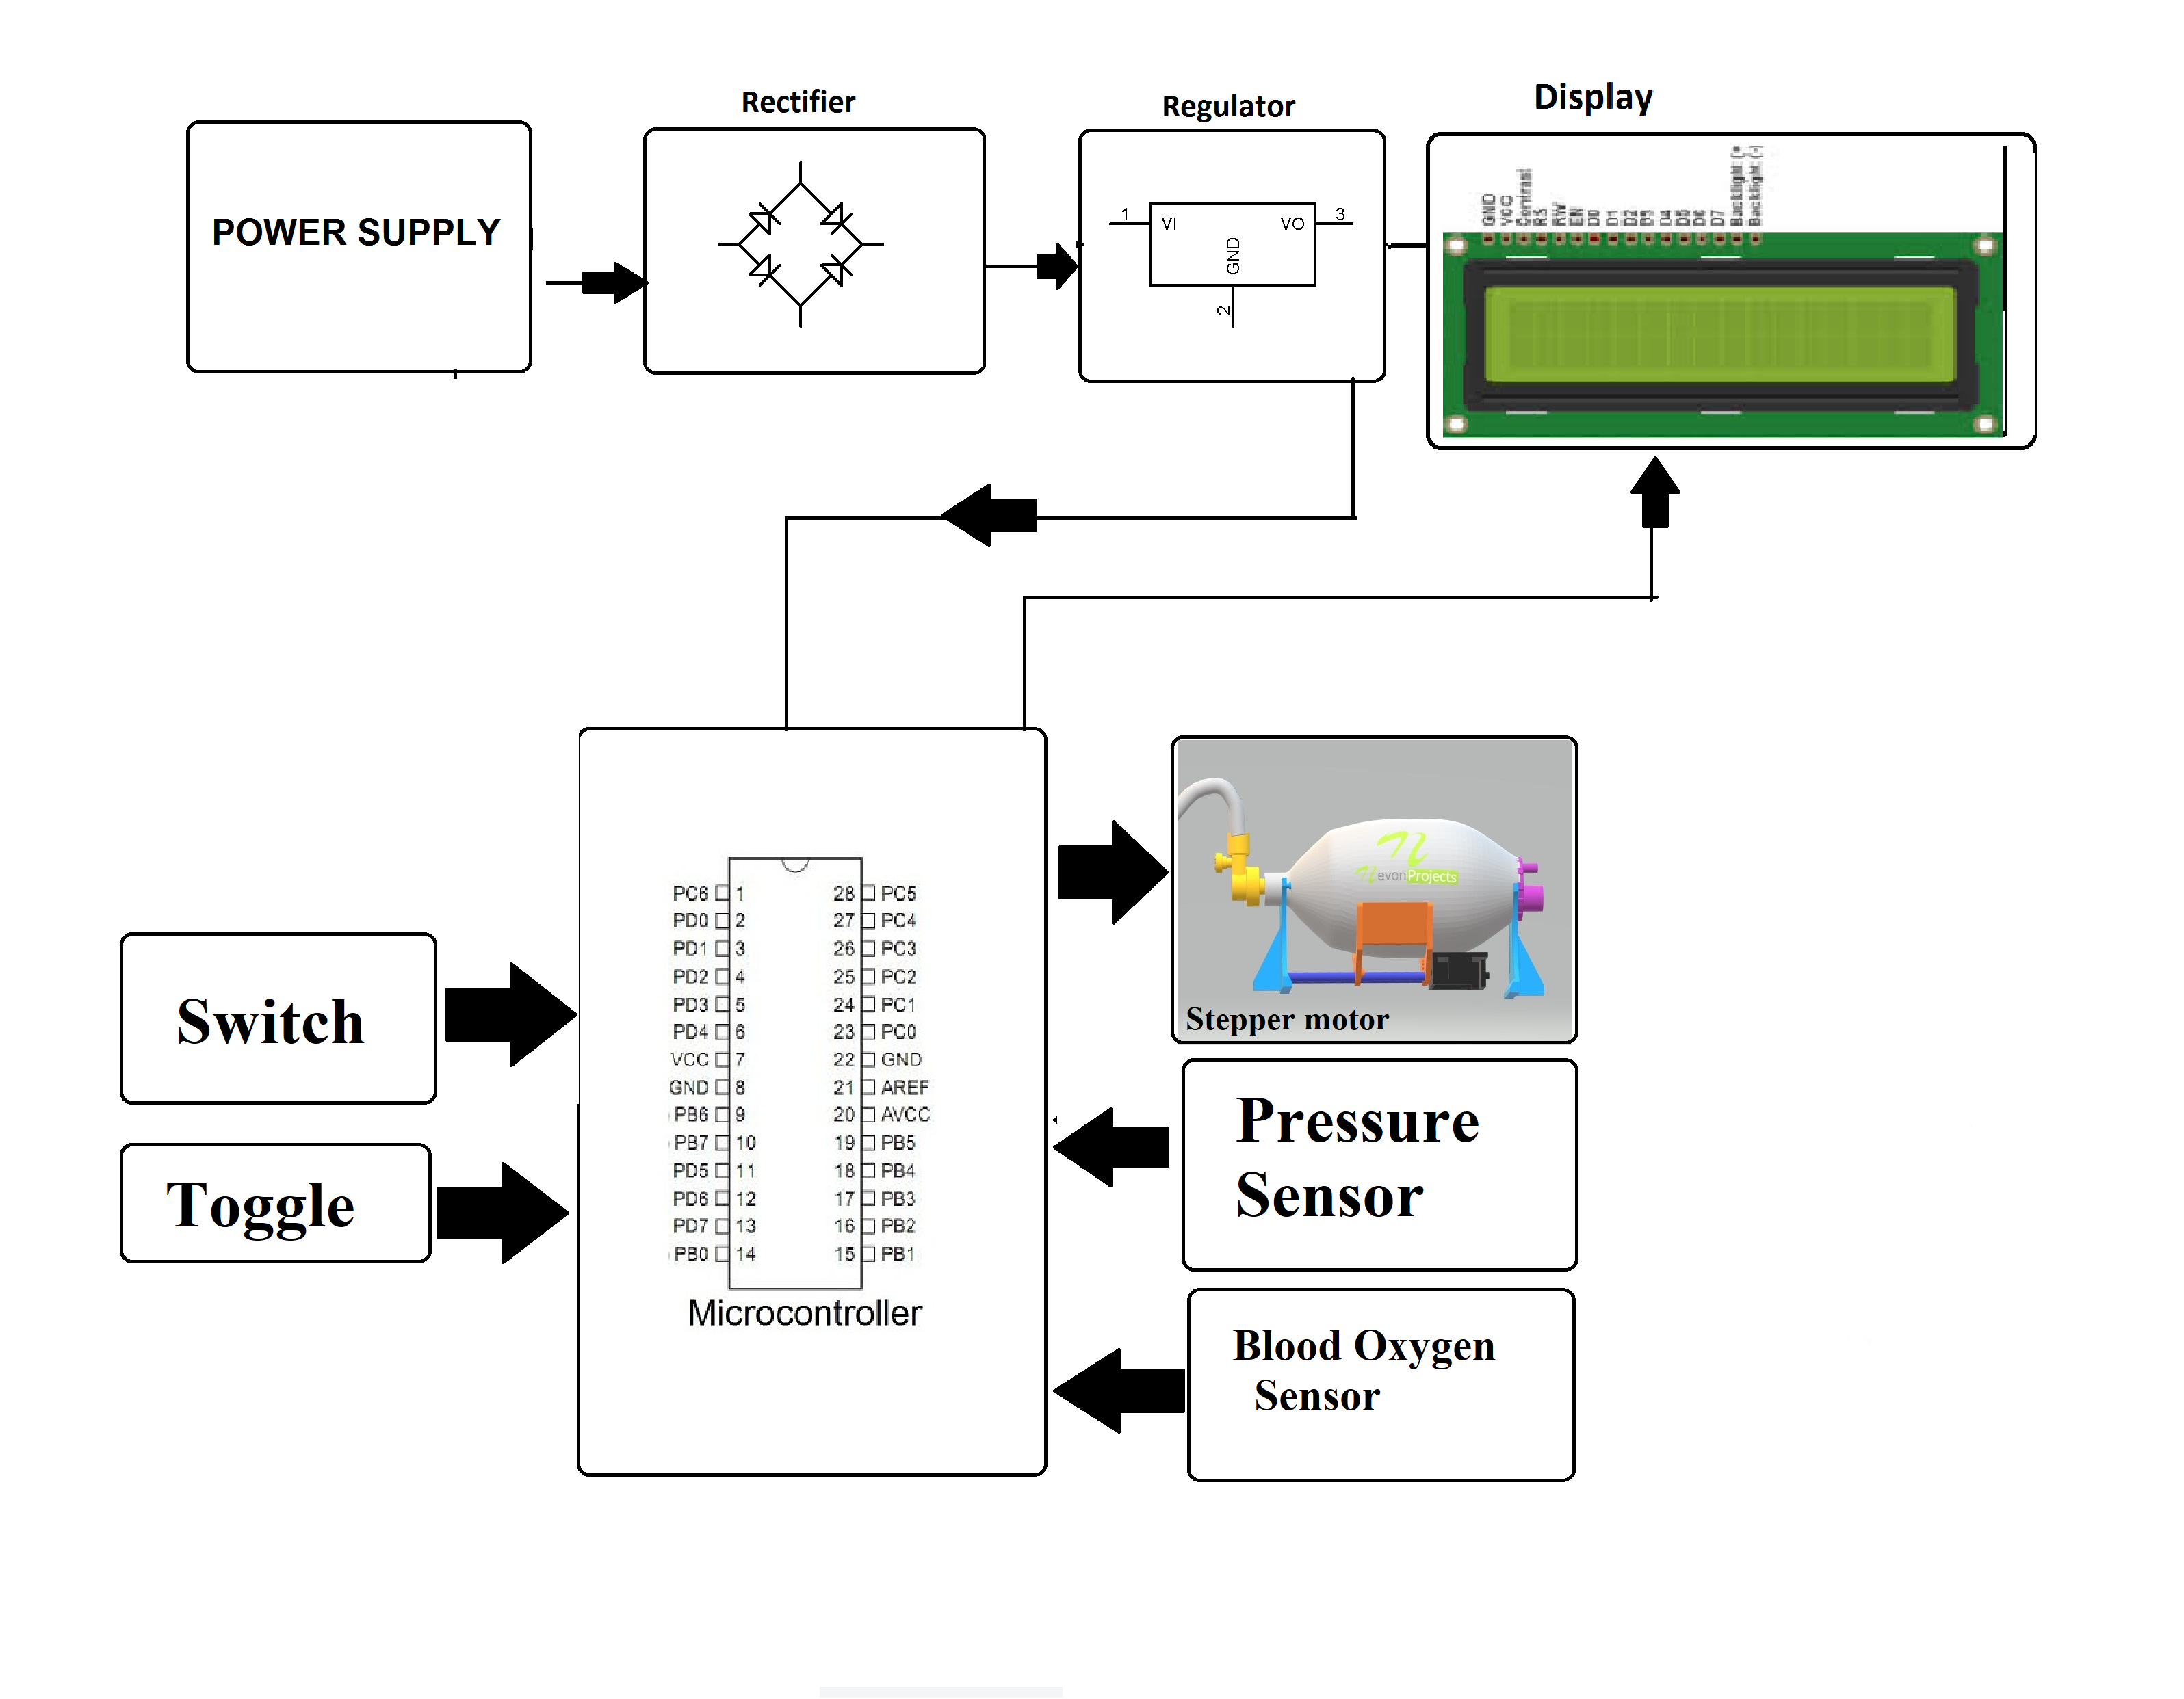
CIRCUIT DIAGRAM

Slide 8
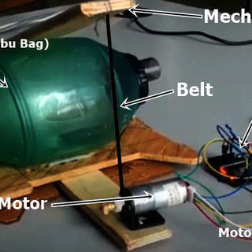

PROJECT DESIGN

Slide 9
Design Considerations
Mechanical Ventilator uses only for pneumonia cases where this type of continuous ventilation machine able to generate a plate pressure (Plat) for lung
Among other features, the machine should have invasive and non-invasive feature, and supports 500 mL tidal volume, with a continuous working capability. Based on calculation, 12 Respiratory rate (RR)/min can provide required amount of tidal volume to the pneumonia patient. Pressure, Volume and Flow control curve.

Slide 10
IMPORTANT HARDWARE AND SOFTWARE COMPONENTS REQUIRED

Slide 11
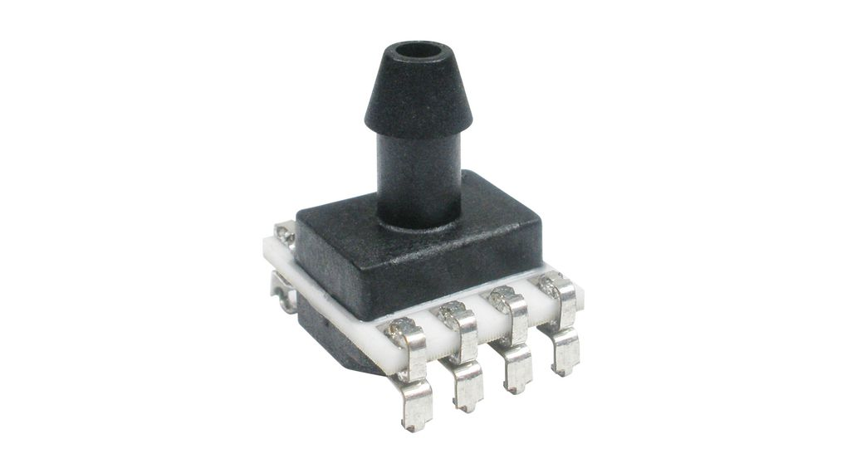
Pressure Sensor
A pressure sensor is a device for pressure measurement of gases or liquids. Pressure is an expression of the force required to stop a fluid from expanding, and is usually stated in terms of force per unit area. A pressure sensor usually acts as a transducer; it generates a signal as a function of the pressure imposed. For the purposes of this article, such a signal is electrical.
Here we are using ---
Board mount pressure sensors are commonly utilized at ultra- low pressure ranges within ventilators to monitor a patient's breathing and detect when filters are clogged and need to be replaced. Honeywell heavy duty pressure sensors monitor and control the flow of air and oxygen delivered to ventilators.

Slide 12
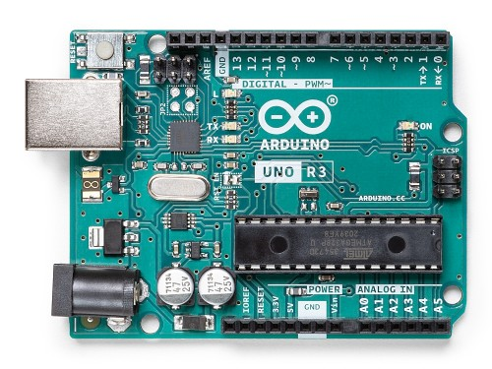
Arduino UNO
Arduino Uno is a microcontroller board developed by Arduino.cc which is an open-source electronics platform mainly based on AVR microcontroller Atmega328.
Arduino Uno comes with USB interface, 6 analog input pins, 14 I/O digital ports that are used to connect with external electronic circuits. Out of 14 I/O ports, 6 pins can be used for PWM output.
Atmega328 microcontroller is placed on the board that comes with a number of features like timers, counters, interrupts, PWM, CPU, I/O pins and based on a 16MHz clock that helps in producing more frequency and number of instructions per cycle.
For this prototype using only few channels. Addition of pressure sensor and volume sensors will increase the safety features. Also, by adding Wi-Fi or Bluetooth module it can be operate remotely using smartphone application

Slide 13
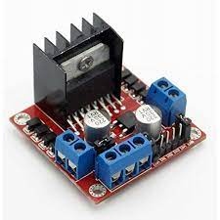
Motor Controller L298
• Motor Controller is used to control the direction of DC motor.
• It consists of an L298 motor driver IC which is capable of rotating the motor in both clockwise and anti clockwise directions by switching its pins from HIGH to LOW and vise versa.
• Required +12V, GND and +5V in order to power it up. So, we will design a voltage regulator which will step down 12V to 5V.
• Using L298 microcontroller, 2 DC motors can easily operate. So simply by adding another DC motor with Ambu bag setup can operate 2 ventilation system at the same time

Slide 14
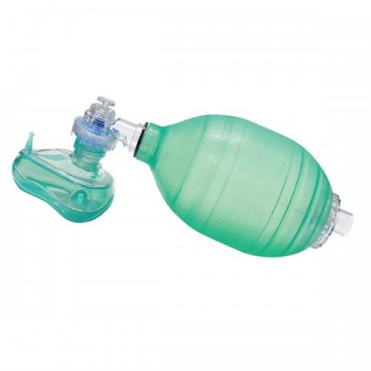
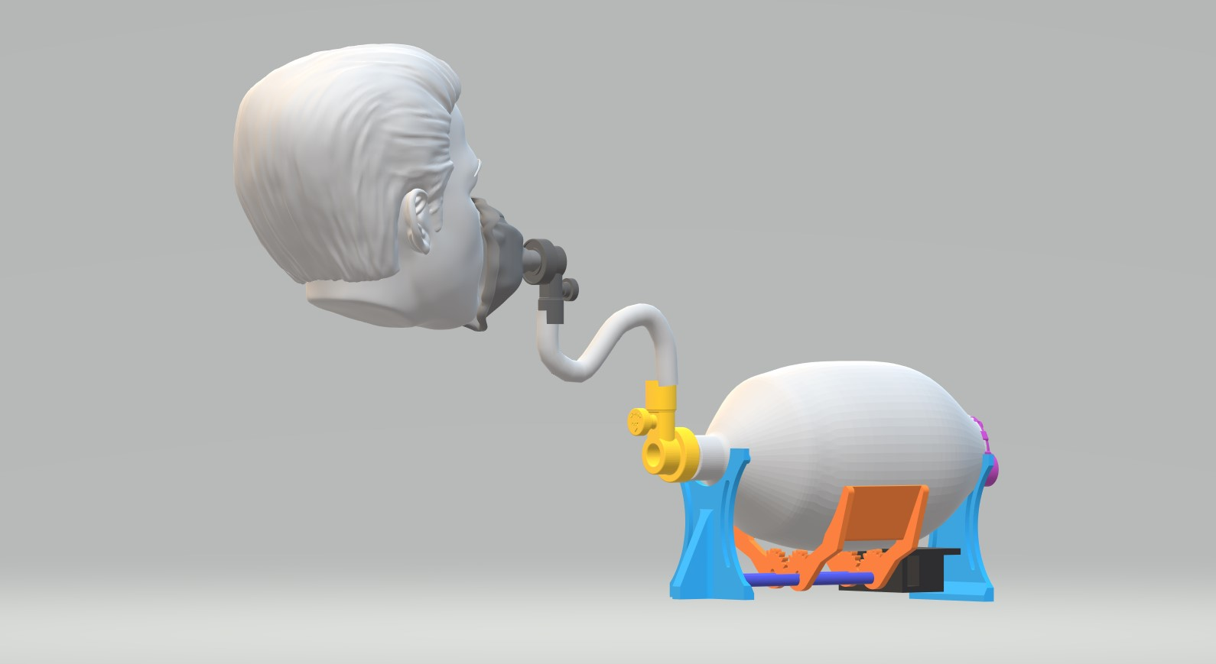
Bag Valve Mask (BVM) or Ambu Bag
• Used for resuscitation in emergency situations, available at local chemists.
• Compressible self refilling ventilation bag with non-re breathing patient valve with pressure limitation valve to minimize the risk of over inflating.
• 100% latex free

Slide 15
ARDUINO IDE
Arduino is an open-source platform used for building electronics projects. Arduino consists of both a physical programmable circuit board (often referred to as a microcontroller) and a piece of software, or IDE (Integrated Development Environment) that runs on your computer, used to write and upload computer code to the physical board.
The Arduino platform has become quite popular with people just starting out with electronics, and for good reason. Unlike most previous programmable circuit boards, the Arduino does not need a separate piece of hardware (called a programmer) in order to load new code onto the board -- you can simply use a USB cable

Slide 16
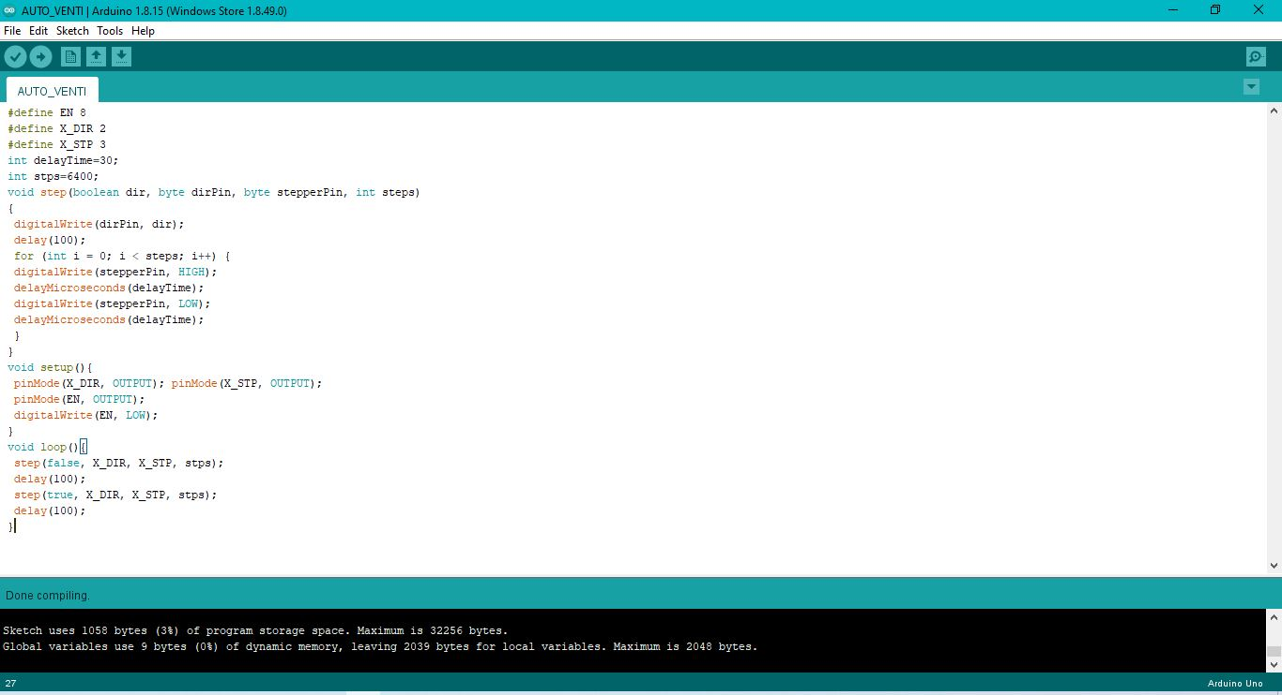
CODE FOR THE PROJECT(NOT COMPLETE)

Slide 17
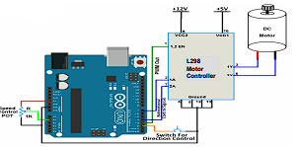
Testing and Results
After implementing of all setup and successful run of Arduino code operated several time to obtain result.
According to our uploaded source code motor will rotate 2 sec clockwise and 3 sec anti clockwise continuously. So that, it can complete 12 Respiratory rate (RR)/min as per our calculation to provide a continuous plate pressure and air flow for the pneumonia cases of COVID-19 patient lungs.
To generate constant ventilation for pneumonia cases such as COVID-19 patients an automated and low-cost ambu bag air flow system is effective to save life.

Slide 18
Applications & USES
Hospitals
Clinics
First Aid Centers
Emergency Situations
Low oxygen area.
Portable
Lab use
Manual Resuscitator

Slide 19
DISADVANTAGES
1.Cannot be used in extreme condition
2. Requires outer oxygen
3. Battery life extend for only 3-3.5 hrs
4. ON high pressure of oxygen ambu bag can crac

Slide 20
Further Enhancements/Recommendations
Taking the current scenario it will reduce extra work and can give accurate data.
Pumping would not be more laborious.
Digital meters will also provide its supply.
It can be used in emergency purpose not only for covid patience but others also.
In hospitals it will be more and more used and the cost will be also less than the cylinders.
More new electronic elements will enhance the device so that it can calculate the oxygen meter of person and provide them with the requirement.
Timers will be used to alert the requirement :- more required or not.

Slide 21
DIFFRENCES OF OUR PROJECT FROM OTHER PRESENT:
Cost will be minimal.
Oxygen calculators will be used.
More and more supply can be done by using direct source.
Timers will be used to explain for hold and use.
Try to increase battery back-up.

Slide 22
CONCLUSION
The work described in this paper aimed at presenting a specific methodological approach to show how be can create this solution.
➢ Designed and developed a prototype of automatic ventilator to support pneumonia cases for COVID-19 patients.
➢ It has a controlled breath rate of 12 RR/min and 500-600 mL tidal volume. It features assist control and provide a constant air flow to the lungs.
➢ Power requirement is very low and running for 3.5 hours on one battery charge at its most demanding setting. Battery backup also need to be checked.
➢ It is low cost, portable, light weight and able to run 2 DC motors at the same time.
➢ Further development includes pressure sensor, air flow meter, over pressure alarm and other safety features to make it more user friendly

Slide 23
REFRENCES:
WIKIPEDIA
https://www.ucihealth.org/news/2020/04/covid-ventilator-design

